Slide 1
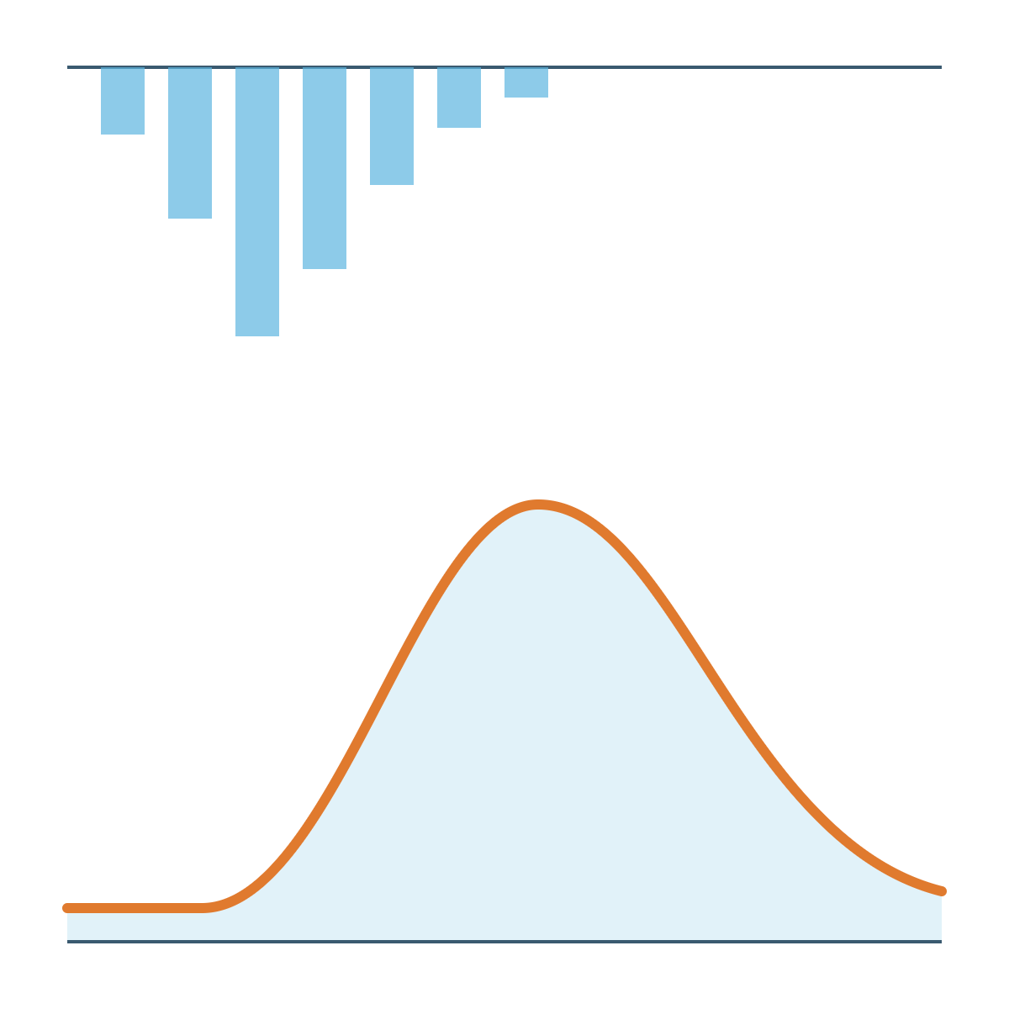
Accelerating flood model development with custom QGIS plugins
FLOOD MODELLING TEAM · KNOWLEDGE SHARE
FMB Tools 0.10 · Rain2Flood v3.0 · Building your own plugin
Rahul Pandey
Senior Engineer, Flood Modelling · AtkinsRéalis · [Date]
Notes:
Introduce yourself. Today: two tools I built to speed up our modelling work, FMB Tools for building TUFLOW models in QGIS (the main focus) and Rain2Flood for hydrology (a bonus), then how anyone in the team can build their own QGIS plugin.

Slide 2
Four parts, one idea: let QGIS do the repetitive work
AGENDA
01
02
03
04
Why
FMB Tools 0.10
Rain2Flood v3.0
Build your own
Where the time goes when TUFLOW models are built by hand
Control files, batch files and QC built inside QGIS
Hydrology from rainfall to flood hydrograph
How a QGIS plugin works and how to start one
Main focus
Bonus
Hands-on
Notes:
Set expectations: most of the time goes on FMB Tools. Rain2Flood is a short bonus. We finish with how to build a plugin, so anyone can turn a repetitive task into a tool.

Slide 3

A TUFLOW model is a stack of hand-edited text files
THE PROBLEM
TYPICAL MODEL FOLDER
model.tcf
model.tgc
Commands typed from memory or copied from an old model
model.tbc
model.ecf
A typo or wrong path only shows up when the run stops
materials.tmf
Checking means reading the log and message layers by hand
bc_dbase.csv
run.bat
Every modeller lays out files a little differently
Notes:
Ask the room: who has lost time to a typo in a control file, or a wrong path that only appeared at run time? The tooling is plain text editors, and that is where most of the friction comes from.

Slide 4
What if the model build lived where the data already lives: in QGIS?
THE QUESTION
That question became FMB Tools.
Notes:
Pause here. Our GIS layers are already in QGIS, so the control files that reference them should be built there too.

Slide 5

Build TUFLOW models inside QGIS, not in Notepad++
FMB TOOLS 0.10
One tab per control file
SCREENSHOT
Batch files generated, not hand-typed
FMB Tools main window
QC, log and results views built in
The plugin open in QGIS with a model loaded
Help tab links to the TUFLOW Wiki
Open source, on GitHub
Notes:
FMB Tools started as "TUFLOW Model Builder" and was renamed. Version 0.10 is what I am showing today. The goal: everything you used to do in Notepad++ for a TUFLOW build now happens in one QGIS panel.

Slide 6

From blank model to checked results in one place
FMB TOOLS 0.10 · WORKFLOW
Step 1
Step 2
Step 3
Step 4
Step 5
Build control files
Create batch file
Run the model
QC and log
Review results
Check messages and the log inside QGIS
TCF, TGC, TBC, ECF and more, one tab each
The .bat is written for you
TUFLOW runs from the generated batch file
Results next to the GIS layers they came from
No switching between a text editor, a file browser and QGIS: the whole build stays in one window.
Notes:
Walk through the five steps quickly here; the next slides show each one with screenshots. If doing a live demo, this is the slide to switch from.

Slide 7
Control files, one tab each
FMB TOOLS 0.10 · STEP 1
Forms, not syntax
Fill in commands and files; the plugin writes the TUFLOW control files.
SCREENSHOT
Every file in one window
Control file tabs
Move between TCF, TGC, TBC and ECF without a text editor.
The TCF tab filled in, with the other file tabs visible
Help on hand
The Help tab links to the TUFLOW Wiki for command details.
Notes:
Show how a control file is built from the tab instead of typed. Point out the Help tab, which saves a separate search of the TUFLOW Wiki.

Slide 8
Batch files without hand-typed paths
FMB TOOLS 0.10 · STEPS 2 AND 3
Generated from your setup
The batch file is built from the model you just defined.
Same structure every time
SCREENSHOT
Run files look alike across the team, so anyone can pick one up.
Batch file builder
The batch tab and the .bat it produces
Run options
[List the run options 0.10 supports, such as events or scenarios]
Notes:
Show the generated .bat side by side with the form. Mention that consistent run files make reviews and hand-overs easier.

Slide 9
QC, log and results without leaving QGIS
FMB TOOLS 0.10 · STEPS 4 AND 5
SCREENSHOT
SCREENSHOT
QC and log view
Results view
Messages and log from a run, read inside QGIS
Model results loaded next to the input layers
Notes:
The point here is closing the loop: build, run, check and review in the same tool. Errors are found in QGIS, next to the layers that caused them, rather than by scrolling a log in a text editor.

Slide 10
What changes for the modeller
FMB TOOLS 0.10 · BEFORE AND AFTER
Task | By hand in Notepad++ | With FMB Tools
Control files | Typed, or copied from an old model | Built from tabbed forms
Batch file | Edited for each run | Generated by the plugin
Finding errors | After a run stops, in the log | QC view inside QGIS
Command help | A separate TUFLOW Wiki search | Help tab linked to the Wiki
Time to first run | [__ hours] | [__ hours]
Notes:
Fill in the last row with a real timing from one of your projects before presenting; one honest number lands better than a general claim.

Slide 11
From rainfall to flood hydrograph, inside QGIS
BONUS · RAIN2FLOOD V3.0
01
02
03
04
Catchment
Rainfall
Runoff
Routing
Streams and sub-basins with GRASS r.watershed
DEM and slope processing with styled outputs
Frequency analysis with several distributions
Design rainfall for chosen return periods
SCS-CN, Green-Ampt and Horton losses
SCS, Snyder, Clark and Nash unit hydrographs
CN rasters from ESA WorldCover and SoilGrids
Muskingum-Cunge channel routing
2D diffusive-wave engine, in development
Notes:
Keep this short: three to five minutes. Rain2Flood covers the hydrology that sits upstream of a hydraulic model. Version 3.0 followed a full hydrology audit and bug-fix pass.

Slide 12
Rain2Flood in action
BONUS · RAIN2FLOOD V3.0
SCREENSHOT
SCREENSHOT
Streams and sub-basins tab
Hydrograph output
A delineated catchment on the map
A design flood hydrograph for one return period
Notes:
Two screenshots are enough: the catchment it delineates and the hydrograph it produces. Mention that hydrographs like these are what feed the inflow boundaries of a hydraulic model.

Slide 13
Plugin development, start to finish
BUILD YOUR OWN
01
02
03
04
Plan
Set up
Scaffold
Design the UI
One task, its inputs and its outputs
QGIS, an editor and helper plugins
Plugin Builder, or three files by hand
Qt Designer with QGIS widgets
05
06
07
08
Write the logic
Test and debug
Package
Share and maintain
PyQGIS and Processing
Reload, log and test
metadata.txt and a clean zip
Team zip, team repository or plugins.qgis.org
Notes:
This is the map for the rest of the section. Each stage gets one or two slides. The message: none of these stages needs a software background, only Python basics and a clear task.

Slide 14
Decide what it does before you write code
STAGE 1 · PLAN
Then pick a plugin type
Dialog or dock plugin
Four questions to answer first
Your own window and workflow. Best for multi-step tools, like the tabbed window in FMB Tools.
1
Which manual task does it replace?
2
What goes in: layers, files, settings?
3
What comes out: files, layers, reports?
Processing provider
4
Who uses it, and on which QGIS version?
Tools in the Processing Toolbox, with batch mode and Model Designer included. Rain2Flood began as one.
Notes:
The most common mistake is starting with the interface. Write the four answers on one page first. Rule of thumb for the type: if it is one input, one output and no back-and-forth, make it a Processing algorithm and get batch runs and model chaining for free. If it is a workflow with several steps, build a dialog or dock.

Slide 15
Your toolkit: all free, mostly already installed
STAGE 2 · SET UP
Tool | What it is for
QGIS LTR | Develop and test on the version the team uses
VS Code or PyCharm | Edit Python with autocomplete and Git built in
OSGeo4W Shell | pip install packages into QGIS's own Python
Plugin Builder 3 | Generates a starter plugin from a form
Plugin Reloader | Reloads your plugin without restarting QGIS
First Aid | Readable error tracebacks and a Python debugger
Qt Designer | Lays out dialogs; installed with QGIS
Git and GitHub | Version history and backup from day one
Notes:
Plugin Builder 3, Plugin Reloader and First Aid are all installed from Plugins, Manage and Install Plugins. On Windows, the OSGeo4W Shell is in the QGIS Start menu folder; pip run from there installs into the Python that QGIS uses, not a separate Python on your machine.

Slide 16
Let Plugin Builder write the boilerplate
STAGE 3 · SCAFFOLD
1
Install Plugin Builder 3 from the Plugin Manager
2
Fill in names, description, author and minimum QGIS version
3
Pick a template: dialog, dock widget or Processing provider
SCREENSHOT
Plugin Builder 3 form
4
Save it into your QGIS plugins folder
The form filled in for a new plugin
5
Enable it in the Plugin Manager and click its button
No resources.py? Compile it with pyrcc5 in the OSGeo4W Shell, or load the icon straight from its file path.
Notes:
Plugin Builder saves an hour of boilerplate. It also generates files many plugins never need, such as i18n folders and a Makefile; it is fine to delete those. The resources.py tip is the most common first stumbling block on Windows.

Slide 17
A QGIS plugin is just a folder of Python files
STAGE 3 · WHAT YOU GET
my_plugin/
Goes in your QGIS profile's plugins folder
├── metadata.txt
Name, version, author, minimum QGIS version
├── __init__.py
classFactory(iface): QGIS calls this to load the plugin
├── my_plugin.py
initGui() adds buttons, unload() removes them, run() does the work
├── my_dialog.ui
The window, laid out in Qt Designer
└── icon.png
The toolbar icon
Windows: %APPDATA%\QGIS\QGIS3\profiles\default\python\plugins
Notes:
Demystify it: no compiler, no installer. Drop the folder into the plugins directory, restart QGIS or use Plugin Reloader, and it appears in the Plugin Manager. FMB Tools and Rain2Flood follow exactly this structure, just with more files.

Slide 18
A working plugin in three small files
STAGE 3 · OR WRITE IT BY HAND
__init__.py
hello.py
def classFactory(iface):
from qgis.PyQt.QtWidgets import QAction, QMessageBox
from .hello import HelloPlugin
class HelloPlugin:
return HelloPlugin(iface)
def __init__(self, iface):
self.iface = iface
def initGui(self):
metadata.txt
self.action = QAction("Hello", self.iface.mainWindow())
[general]
self.action.triggered.connect(self.run)
name=Hello Flood Team
self.iface.addToolBarIcon(self.action)
qgisMinimumVersion=3.22
def unload(self):
description=My first plugin
self.iface.removeToolBarIcon(self.action)
version=0.1
def run(self):
author=Your Name
layer = self.iface.activeLayer()
email=you@example.com
name = layer.name() if layer else "none"
QMessageBox.information(None, "Hi", f"Layer: {name}")
Notes:
Put these three files in a folder called hello inside the plugins folder (the import in __init__.py points at hello.py). Enable it in the Plugin Manager and a button appears that shows the active layer's name. Everything else, including FMB Tools, is this pattern plus a dialog and real logic. Before publishing to plugins.qgis.org, metadata.txt also needs about, repository and a licence.

Slide 19
Draw the window, then load it in Python
STAGE 4 · DESIGN THE UI
QGIS widgets worth knowing
my_dialog.py
QgsMapLayerComboBox
import os
Pick a layer from the project
from qgis.PyQt import uic
from qgis.PyQt.QtWidgets import QDialog
FORM, _ = uic.loadUiType(os.path.join(
QgsFieldComboBox
os.path.dirname(__file__), "my_dialog.ui"))
Pick a field from that layer
class MyDialog(QDialog, FORM):
def __init__(self, parent=None):
super().__init__(parent)
QgsFileWidget
self.setupUi(self)
Browse for a file or folder
QgsProjectionSelectionWidget
Choose a coordinate system
Use the Qt Designer that comes with QGIS, so these widgets appear in its widget list.
Notes:
Lay out the window in Qt Designer and save the .ui file next to your code. Loading it at run time with loadUiType means you can change the layout without touching Python. The QGIS widgets keep themselves in sync with the project: the layer list updates when layers are added or removed.

Slide 20
Five PyQGIS pieces do most of the work
STAGE 5 · WRITE THE LOGIC
iface
The QGIS window: map, toolbars, message bar
run() in my_plugin.py
import processing
QgsProject.instance()
layer = self.dlg.layerCombo.currentLayer()
processing.runAndLoadResults("native:buffer", {
The open project and its layers
"INPUT": layer,
"DISTANCE": 10,
"OUTPUT": "TEMPORARY_OUTPUT",
QgsVectorLayer · QgsRasterLayer
})
Read, edit and create data
self.iface.messageBar().pushSuccess(
"My Plugin", "Buffer created")
processing
Call any Processing Toolbox tool from code
Tip: run a tool once in the Processing Toolbox, then use Advanced › Copy as Python Command to get the exact call.
QgsTask
Run long jobs without freezing QGIS
Notes:
The dialog collects the inputs, run() does the work. Most flood-modelling tasks are chains of existing Processing tools (clip, buffer, zonal statistics, raster calculator), so you rarely write geometry code yourself. The Copy as Python Command tip removes the guesswork about parameter names.

Slide 21
A short loop: edit, reload, check
STAGE 6 · TEST AND DEBUG
Plugin Reloader
Python Console
Log Messages panel
Save, reload, click: see each change in seconds.
Try each PyQGIS line before it goes into the plugin.
QgsMessageLog writes progress and warnings to your plugin's own tab.
First Aid
pytest
A clean machine
Shows the traceback and variables when something fails.
Keep calculations out of the GUI code, so they can be tested on their own.
Install the zip on a colleague's PC before every release.
Notes:
The pytest card is the one engineers should take away. Rain2Flood's hydrology checks are regression tests that run outside QGIS, which is how formula errors stay fixed. The clean-machine test catches missing packages and hard-coded paths that never show up on your own PC.

Slide 22
Five problems almost every first plugin hits
STAGE 6 · COMMON PROBLEMS
Symptom | Cause | Fix
QGIS freezes during a run | Heavy work on the main thread | Move it into a QgsTask or a Processing algorithm
Duplicate buttons after reload | unload() leaves actions behind | Remove every action and menu in unload()
Works only on your PC | Hard-coded paths or missing packages | Build paths from __file__; check imports and tell users what to install
Breaks on a newer QGIS | PyQt5 imported directly | Import from qgis.PyQt instead
Slow on large rasters | Looping cell by cell in Python | Use NumPy arrays, GDAL or Processing tools
Notes:
Each of these came up while building FMB Tools or Rain2Flood. The qgis.PyQt import matters more now that QGIS is moving to Qt6: code that imports PyQt5 directly will not load there. The raster one is the Rain2Flood delineation story: the vectorised version was dramatically faster than the pure-Python loop.

Slide 23
A complete metadata.txt and a clean zip
STAGE 7 · PACKAGE
ZIP STRUCTURE
Required
Recommended
my_plugin.zip
name
qgisMinimumVersion
description
about
version
author
email
repository
tracker
homepage
tags
icon
changelog
experimental
└── my_plugin/
├── metadata.txt
├── __init__.py
├── my_plugin.py
├── my_dialog.ui
└── icon.png
Leave out __pycache__, .git and test data. Test the zip with Plugins › Manage and Install Plugins › Install from ZIP.
Notes:
The folder inside the zip must be the plugin's module name, the same name as the folder in your plugins directory. The required fields are the ones plugins.qgis.org checks on upload; filling them in now saves a rejected upload later. Set experimental=True for early versions so only users who opt in see them.

Slide 24
Three ways to get it to users
STAGE 8 · SHARE AND MAINTAIN
Team zip
Team repository
plugins.qgis.org
Send the zip; colleagues use Install from ZIP.
Host a plugins.xml on a shared server and add it in the Plugin Manager settings.
Public. Needs an OSGeo account, a GPL-compatible licence and a public code repository.
Quickest, but no update notices.
Colleagues get update notices.
Reviewed before it goes live.
AFTER RELEASE
Bump version and changelog each release
Track bugs as GitHub issues
Retest on each new QGIS LTR
Notes:
For work tools, check the company's IP and open-source policy before publishing on plugins.qgis.org; a team repository is often the right middle ground. Once published, every version bump in metadata.txt shows users an update in their Plugin Manager.

Slide 25
What building these taught me
LESSONS FROM FMB TOOLS AND RAIN2FLOOD
Start with one annoying task
Expect to rewrite the engine
FMB Tools began with a single goal: stop editing TUFLOW files in Notepad++.
Rain2Flood's delineation went from pure-Python D8 to pysheds, then a vectorised sparse search, then GRASS r.watershed.
Check the science, not just the code
Lock in fixes with tests
A hydrology audit found FEH QMED formula errors that were underestimating flows.
Regression tests and NumPy 2.0 fixes keep v3.0 working as libraries change.
Notes:
The QMED story is the one to tell: the code ran without errors but gave low flows. Tools that look finished still need an engineering check, which is where this team's expertise matters most.

Slide 26
Where to start
RESOURCES
Resource | Link
PyQGIS Developer Cookbook | docs.qgis.org/latest/en/docs/pyqgis_developer_cookbook
PyQGIS API reference | qgis.org/pyqgis
QGIS plugin repository | plugins.qgis.org
TUFLOW Wiki | wiki.tuflow.com
FMB Tools and Rain2Flood | github.com/rahulpandey696
Notes:
Share this slide or the links after the session. The Cookbook is the best single starting point; the API reference is for looking up classes once you know what you need.

Slide 27
Bring me your repetitive tasks
QUESTIONS
The next plugin could start with a problem from your project.
Rahul Pandey · github.com/rahulpandey696
Notes:
Open the floor. Ask the team for the most repetitive step in their current project; note them down as candidates for the next tool.

